Slide 1
Uncertainty Propagation and Sensitivity Analysis
Miodrag Bolic
Associate Professor
School of Electrical Engineering and Computer Science (EECS)
Faculty of Engineering

Slide 2
Goal
Introduce an uncertainty framework
Show several biomedical applications
Focus on resampling methods
Bootstrap, Monte Carlo

Slide 3
Uncertainty quantification
Uncertainty Quantification (UQ) aims at developing rigorous methods to characterize the impact of ”limited knowledge” on quantities of interest.
Statistics of an outcome of interest, such as its expectation and the variance, commonly requires the evaluation of integrals
Uncertainty is usually summarized through confidence intervals
Notes:
Limited knowledge – can be resuced by repeated experiments – epistemic
Aliatory uncertainty is natural variability and cannot be reduced – for example if we have wind velocity as an input to the model it changes over time
Regarding the characterization of uncertainties both direct and inverse methods are at disposal. Among the direct methods, the experimental observations, theoretical arguments and also expert opinions are the principal; inference and calibration are, instead, the fundamental techniques to translate observed data in statistical input parameters. The propagation process is the ensemble of operations which allows to obtain the uncertain outputs prescribing, to the uncertain model, the uncertain inputs. In this work the focus is totally devoted to aleatory, i.e. stochastic uncertainties, so in this case the probability framework plays a special role not only for the characterization of the sources of uncertainties, but also for their propagation. The final UQ step involves the analysis of the ensemble of output quantities of interest in term of probability distributions, cumulative distributions or other statistic characterization of data. Moreover, also sensitivity analysis (SA) of the data could be of interest. In the Part II of this thesis examples, of how the SA analysis can be employed to improve the understanding of complex system, will be provided. However, even if they are related, it is important to underline the difference between UQ and SA. Sensitivity analysis investigates the connection between inputs and outputs of a model and, in particular, it makes possible to relate the variability of the outputs to the variability of the inputs. SA does not need input data and can be conducted on purely mathematical analysis, while the UQ, given a system, aims to quantify its output uncertainty. The meaning of SA in the design context appears clear: large variations of some (identified) parameters generate large variations of the outputs. In the UQ context, however, a large sensitivity of a parameter is not strictly connected to large
uncertainties. In fact uncertainties related to input parameters, to which the system is greatly sensitive, could be so small to induce no uncertainty on the outputs at all. Moreover, it could be important determining how the uncertain structure of all the inputs maps the uncertain structure of all the outputs. In this case the SA is named global SA and its importance becomes crucial in the light of improving the quality of the model itself identifying the sources of a lack of knowledge. For instance, in the case of complex coupled physics phenomena, a global SA can indicate the relevant physical experiments to conduct to most reduce the epistemic uncertaint
From https://tel.archives-ouvertes.fr/tel-00954413/file/GERACI_GIANLUCA_2013_RED.pdf

Slide 4
Verification determines how well the computational model solves the math-model equations
Validation determines how well the model represents the true physical system
Involves comparisons between QOIs computed by the model and corresponding true, physical QOIs inferred from physical observations or experiments.

Slide 5
Observing nature and predicting events
Observations: we are unable to observe and/or predict nature accurately
the limited accuracy of measurement instruments,
the exceedingly high cost of performing accurate experiments and/or measurements,
the lack of accurate models or the computational need of using simplified ones.
Predictions: the result of a combination of measurements, modeling and simulations
Models are based on certain levels of approximation, introduced to make them manageable

Slide 6
Modeling Approach
Advantages
Concise summary of present knowledge of operation of a particular system
Predict outcomes of modes of operation not easily studied experimentally
Clarify or simplify complex experimental data
Suggest new experiments to advance understanding of a system
Limitations
Models often require many simplifying assumptions
beware of garbage in, garbage out
Validation of model predictions is essential

Slide 7
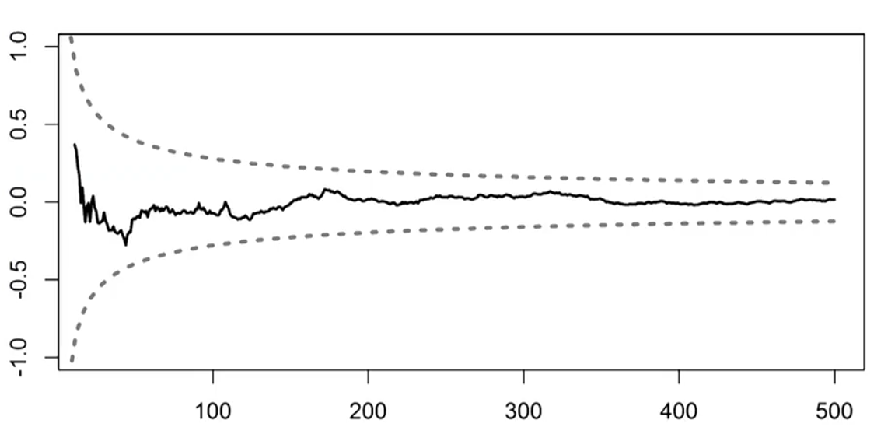
Examples of presenting uncertainty
Standard error
Heart rate is (60 ± 4) beats/minute (mean ± standard error)
Confidence levels
95% confidence for the heart rate is [52,68] beats/minute
Probability distributions
Determining different moments or quantiles
Prediction levels over time
Notes:
Intro to uncertainty quantification: https://nanohub.org/resources/10694

Slide 8
The workflow of Uncertainty Quantification
Step C’: Sensitivity analysis
Step C: Uncertainty propagation
Step A: Definition of the model
Step B: Quantifying sources of uncertainty
- Modeling with probability distributions
Input
Variables
Uncertain: x
Fixed: u
Model
f(x,u)
Variables
of interest
Y=f(x,u)
Quantity of interest
Probability
CI
Measurement data
Step B’: Model calibration, Parameter estimation
Test data
Step D: Decision and prediction under uncertainty (in real time)
Based on OpenTURNS:
http://www.openturns.org/
Notes:
Michaël Baudin, Anne Dutfoy, Bertrand Iooss and Anne-Laure Popelin, OpenTURNS : An industrial software for uncertainty quantification in simulation, arXiv:1501.05242v2 [stat.CO] 5 Jun 2015.
Resources:
Bigoni, Daniele; Engsig-Karup, Allan Peter, Uncertainty Quantification with Applications to Engineering Problems, Technical University of Denmark
Based on OpenTurns

Slide 9
Step B: Quantification of uncertainty sources
A lot of data
Fitting of probability distributions
Statistical hypothesis test
Few data (n < 10)
Hypothesis on parametric probability distribution
Expert judgement, then Bayesian inference
No data
Expert judgment techniques
Taking into account the dependency between inputs is a
crucial issue in uncertainty analysis
Notes:
Copied from the slides:
Bertrand Iooss, Treatment of uncertainties in numerical simulation, 29/11/2012
Correlations can be taken into account in the uncertainty propagation and sensitivity analysis.
Sometimes we can transform correlated into uncerralaterd variables:
For Normal correlated use Cholesky decomposition
For non-normal correlated variables Nataf transformation can be used – it is implemented in Dakota tool.
Karhunen- Luove expansion is the method based on PCA that is commonly used

Slide 10
Step B’: Model Calibration
Model calibration is the process of adjusting unknown model parameters in order to improve the agreement between model output and observed data
Involves “tuning” values of the parameters of the model to best match the observed data
Methods
Maximum likelihood methods
Model is used with fitted parameters to predict future behavior of the system
Bayesian methods for parameter estimation
the predictions allow for all sources of uncertainty, including the remaining uncertainty over the fitted parameters

Slide 11
Step C: Uncertainty propagation
Aim is to quantify output uncertainties
Allows us to place confidence on model predictions
a first step in providing trust in model predictions.
Metrology: Uncertainty budget
Combine all the uncertainties and then see what components in your systems need to be replaced/improved
Quality control:
Meeting design specification of your device

Slide 12
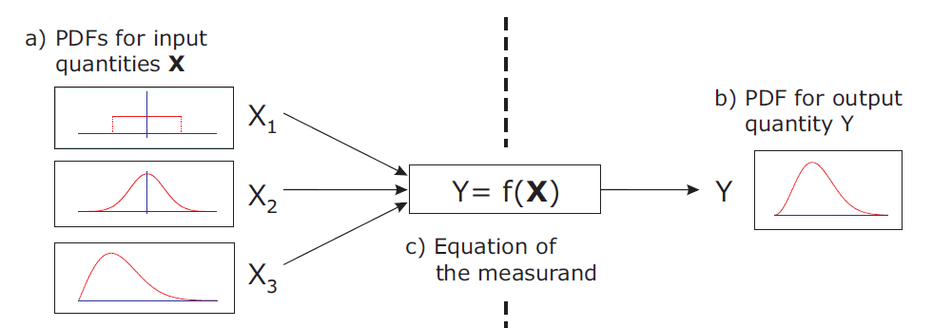
Step C: Propagation of uncertainty
Perturbation methods
the solution is expressed using a suitable Taylor series expansion
Sampling techniques
Monte Carlo based

Slide 13
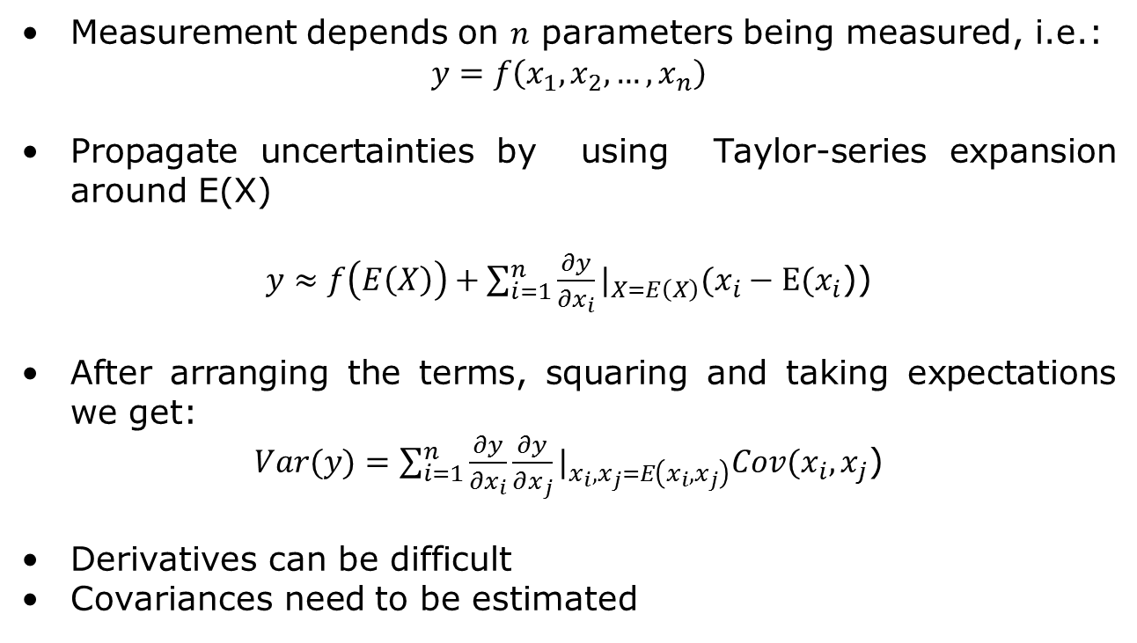
Perturbation methods
Measurement depends on $n$ parameters being measured, i.e.:
$$y=f\left(x_{1},x_{2},…,x_{n}\right)$$
Propagate uncertainties by using Taylor-series expansion around E(X)
$y≈f\left(E\left(X\right)\right)+\sum_{i=1}^{n}{\frac{∂y}{∂x_{i}}}|_{X=E\left(X\right)}(x_{i}−E(x_{i}$))
After arranging the terms, squaring and taking expectations we get:
$Var(y)=\sum_{i=1}^{n}{\frac{∂y}{∂x_{i}}}\frac{∂y}{∂x_{j}}|_{x_{i},x_{j}=E\left(x_{i},x_{j}\right)}Cov(x_{i},x_{j}$)
Derivatives can be difficult
Covariances need to be estimated

Slide 14
Uncertainty propagation for pulse oximeter
A. Cysewska-Sobusiak, "Estimation of Uncertainty in Complex Biomeasurements," IEEE Workshop on Advanced Methods for Uncertainty Estimation in Measurement, 2007, pp. 24-29.
Notes:
A. Cysewska-Sobusiak, "Estimation of Uncertainty in Complex Biomeasurements," 2007 IEEE International Workshop on Advanced Methods for Uncertainty Estimation in Measurement, Sardagna, 2007, pp. 24-29.

Slide 15
Uncertainty propagation for pulse oximeter
Step C: Uncertainty propagation
Step A: Definition of the model
Step B: Quantifying sources of uncertainty
- Distributions of the inputs U_{p1}, U_{o1}, U_{p2}, U_{o2}
Input Variables
Uncertain: U_{p1}, U_{o1}, U_{p2}, U_{o2}
Model
f(U)
Quantity of interest
Saturation+ CI
Step B’: Calibration to determine bias
Test data
Measurement data
Step D: Estimation of Saturation+ CI
Notes:
Michaël Baudin, Anne Dutfoy, Bertrand Iooss and Anne-Laure Popelin, OpenTURNS : An industrial software for uncertainty quantification in simulation, arXiv:1501.05242v2 [stat.CO] 5 Jun 2015.
Resources:
Bigoni, Daniele; Engsig-Karup, Allan Peter, Uncertainty Quantification with Applications to Engineering Problems, Technical University of Denmark

Slide 16
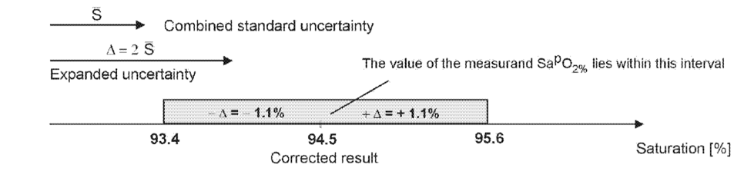
Framework 2 – Uncertainty propagation for pulse oximeter

Slide 17

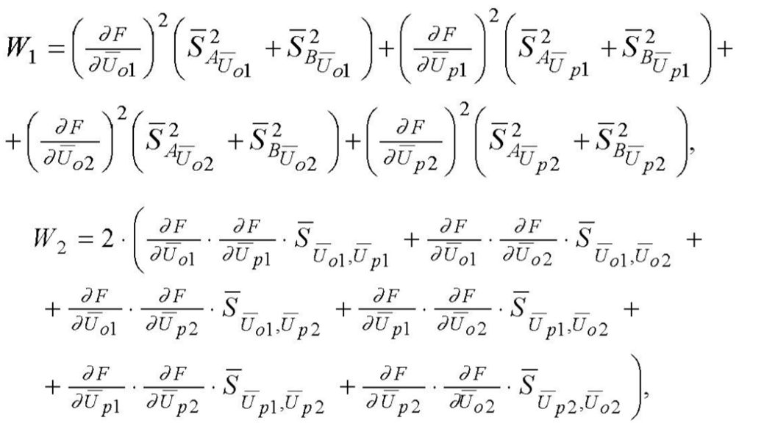
Computing the uncertainty

Slide 18
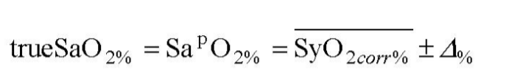
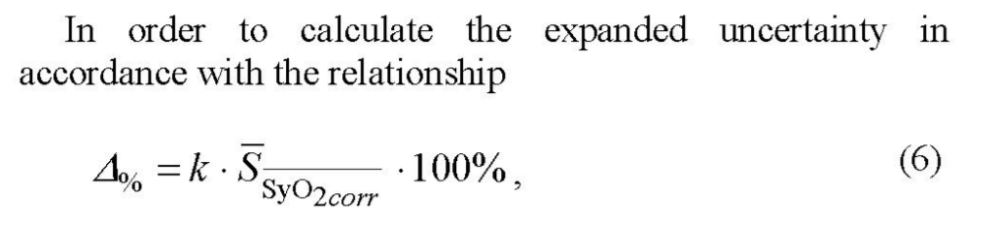
Results

Slide 19


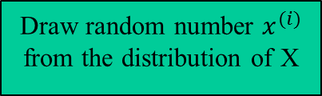
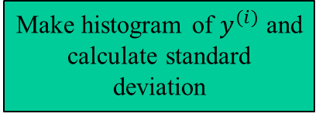


Step C’: Propagation of uncertainties based on Monte Carlo
Propagate of uncertainties “through” function f
Distribution of measurement errors and input uncertainties has been determined
Works for non-linear models
Disadvantages
Slow convergence
Draw random number $x^{(i)}$ from the distribution of X
$$y=f(x)$$
Compute $y^{(i)}=f\left(x^{\left(i\right)}\right)$
i=M
Make histogram of $y^{(i)}$ and calculate standard deviation
Notes:
Distribution of measurement errors and input uncertainties has been determined – experimentally or using Bayesian methods

Slide 20
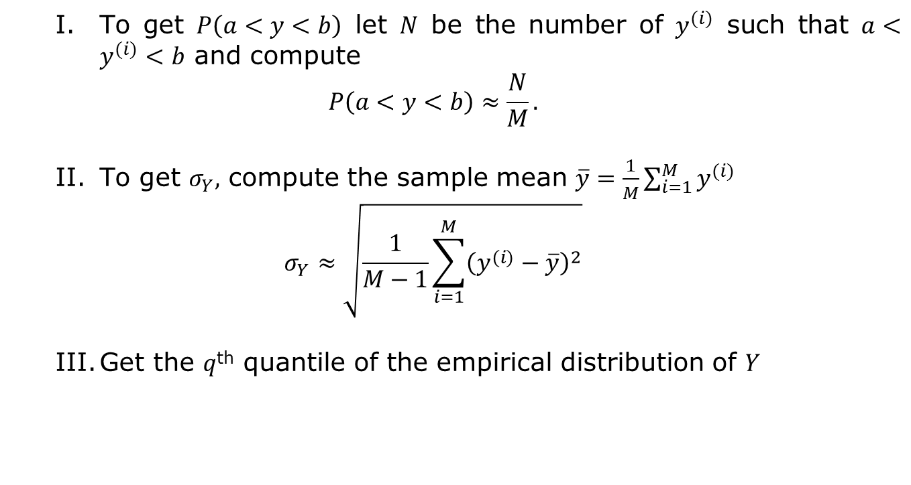
Monte Carlo based propagation of uncertainty
To get $P\left(a<y<b\right)$ let $N$ be the number of $y^{(i)}$ such that $a<y^{(i)}<b$ and compute
$$P\left(a<y<b\right)≈\frac{N}{M}.$$
To get $σ_{Y},$ compute the sample mean $\overline{y}=\frac{1}{M}\sum_{i=1}^{M}{y^{(i)}}$
$$σ_{Y}≈\sqrt{\frac{1}{M−1}\sum_{i=1}^{M}{{\left(y^{(i)}−\overline{y}\right)}^{2}}}$$
Get the $q$^{th} quantile of the empirical distribution of $Y$
Notes:
Analysis of Neural Data

Slide 21
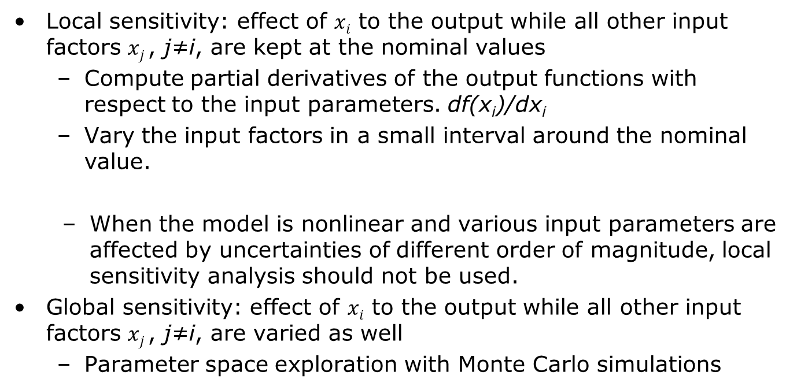
Step C’: Sensitivity analysis
Local sensitivity: effect of $xi$ to the output while all other input factors $xj$, j≠i, are kept at the nominal values
Compute partial derivatives of the output functions with respect to the input parameters. df(x_{i})/dx_{i}
Vary the input factors in a small interval around the nominal value.
When the model is nonlinear and various input parameters are affected by uncertainties of different order of magnitude, local sensitivity analysis should not be used.
Global sensitivity: effect of $xi$ to the output while all other input factors $xj$, j≠i, are varied as well
Parameter space exploration with Monte Carlo simulations
Notes:
Morris Elementary Effects
Perform local sensitivity on the grid and definesensitivity metrics
Sobol indices
Variance based decomposition method

Slide 22
Step C’: Sensitivity analysis
Sensitivity analysis investigates the relationship between inputs and outputs of a model
it makes possible to relate the variability of the outputs to the variability of the inputs.
Does not need input data and can be conducted on purely mathematical analysis
Identifies the most important parameters in the model
Helps reducing the dimension of the model by fixing unimportant parameters
Focus: global variability of the model output, measured by its variance.

Slide 23
GUM-base approach Types of uncertainty
An error δ = measured value– “true” value of density
An uncertainty u is an estimate of an interval ±u that should contain an error.
GUM categorization :
Type A: “method of evaluation of uncertainty by the statistical analysis of series of observations”
Type B: “method of evaluation of uncertainty by means other than the statistical analysis of series of observations”

Slide 24
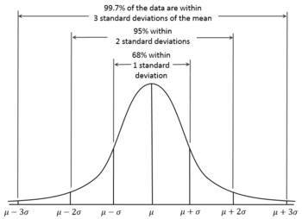
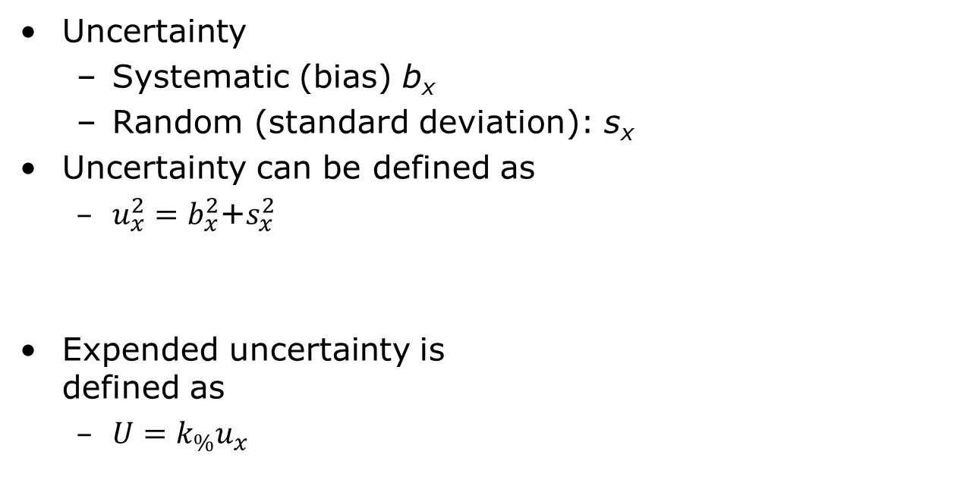
Expended Uncertainty
Uncertainty
Systematic (bias) b_{x}
Random (standard deviation): s_{x}
Uncertainty can be defined as
$u_{x}^{2}=b_{x}^{2}$+$s_{x}^{2}$
Expended uncertainty is defined as
$U=k_{\%}u_{x}$

Slide 25
Definitions
Standard uncertainty
uncertainty of the result of a single type of measurement includes Type A and/or Type B uncertainties
Expanded uncertainty
the standard uncertainty multiplied by a coverage factor
Standard error SE
Standard deviation of the sample statistics

Slide 26
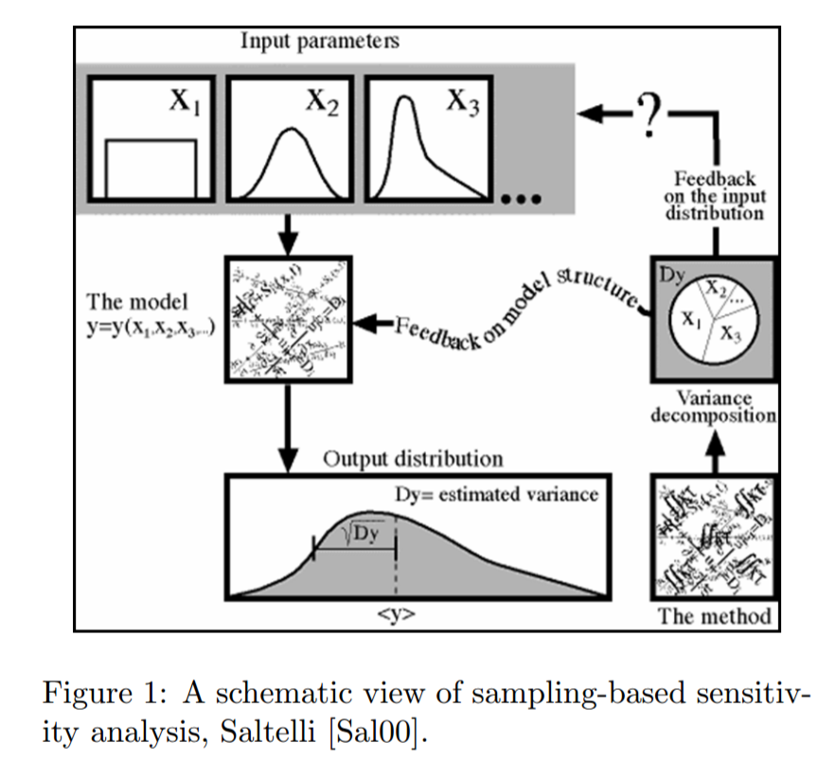
Step C’: Sensitivity analysis

Slide 27
Example: Modeling blood pressure monitoring
Notes:
File: model and measurement

Slide 28
Framework 2 Example: Modeling blood pressure monitoring

Slide 29
Framework 2 Example: Modeling blood pressure monitoring
Step C’: Sensitivity analysis – reducing the number of param. of the model
Step A: Definition of the model
Step B: Quantifying sources of uncertainty
- Setting ranges and distributions of param.
Input Variables
Uncertain: elasticity of arteries, …
Fixed: age, cuff size
Model
f(x,u)
Quantity of interest
Sys/Dia blood pressure
Arterial stiffness param.
Step B’: Model calibration
– SP 10 standard
Test data
Oscillometric measurement data
Step D: - Estimation of arterial stiffness
- Estimation of Sys/Dia blood pressure with CI
Notes:
Resources:
Bigoni, Daniele; Engsig-Karup, Allan Peter, Uncertainty Quantification with Applications to Engineering Problems, Technical University of Denmark

Slide 30
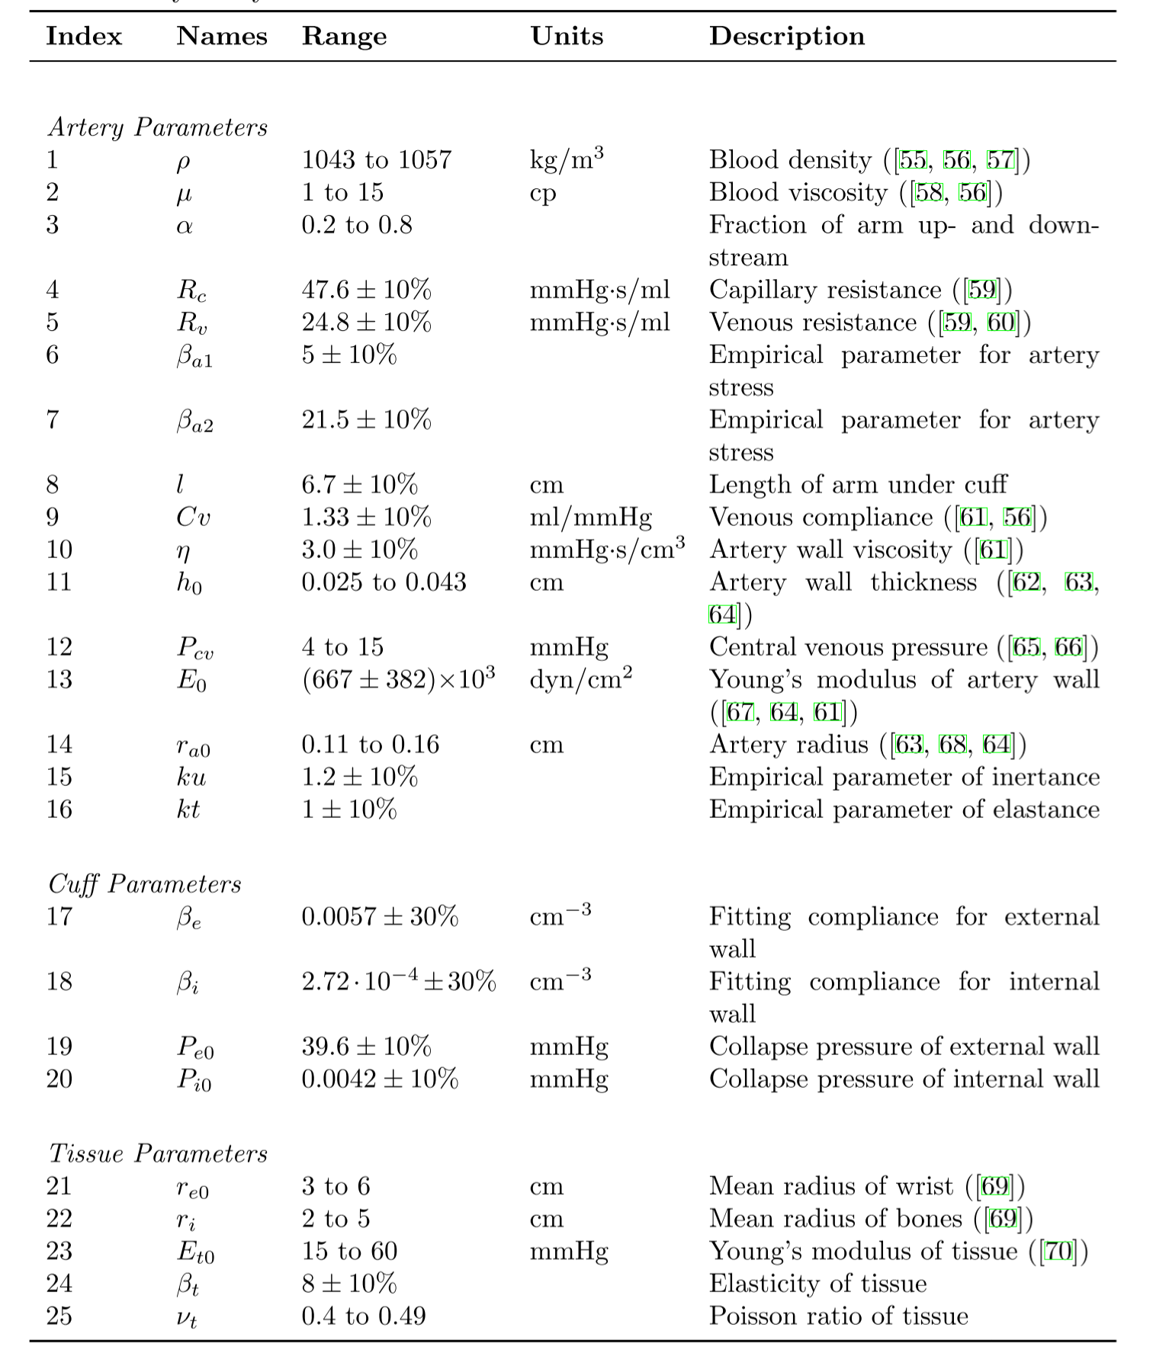
Example Sensitivity Analysis
Mathematical model of the artery, tissue and the cuff
Sensitivity analysis to determine most sensitive parameters of the model
Reduced analysis to 7 parameters
Derived compensation function that include estimation using fixed parameters such as regular BP device and then compensation based on linear regression.
Matthew James, Simplified Model for the Design of an Oscillometric Blood Pressure Measuring System, PhD Thesis, University of Guelph, 2012
Notes:
C:\Users\Bolic\Dropbox\Backup\doc\data quality paper\James_Matthew_20130114_Phd

Slide 31
Sensitivity analysis with Monte Carlo simulations
Generate samples from a parameter space
Which distribution we chose?
Is every parameter combination equally meaningful?
Pass the parameters to the model
Measure association between the result and each parameters
Matlab sensitivity toolbox

Slide 32
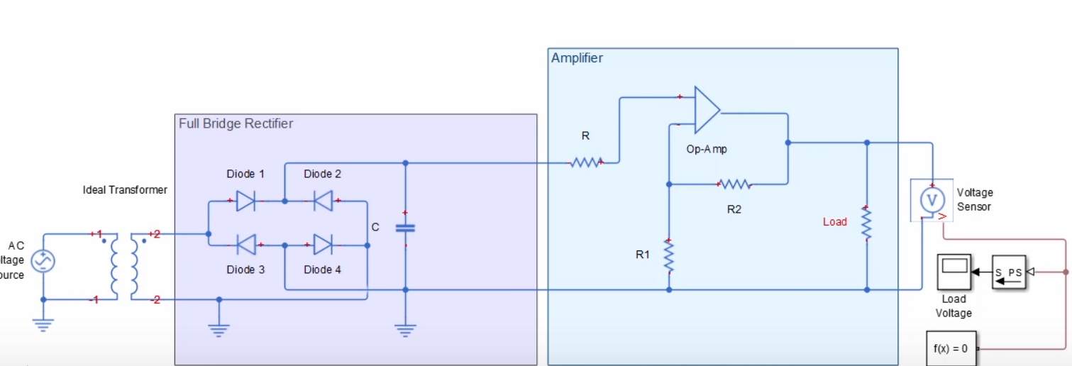
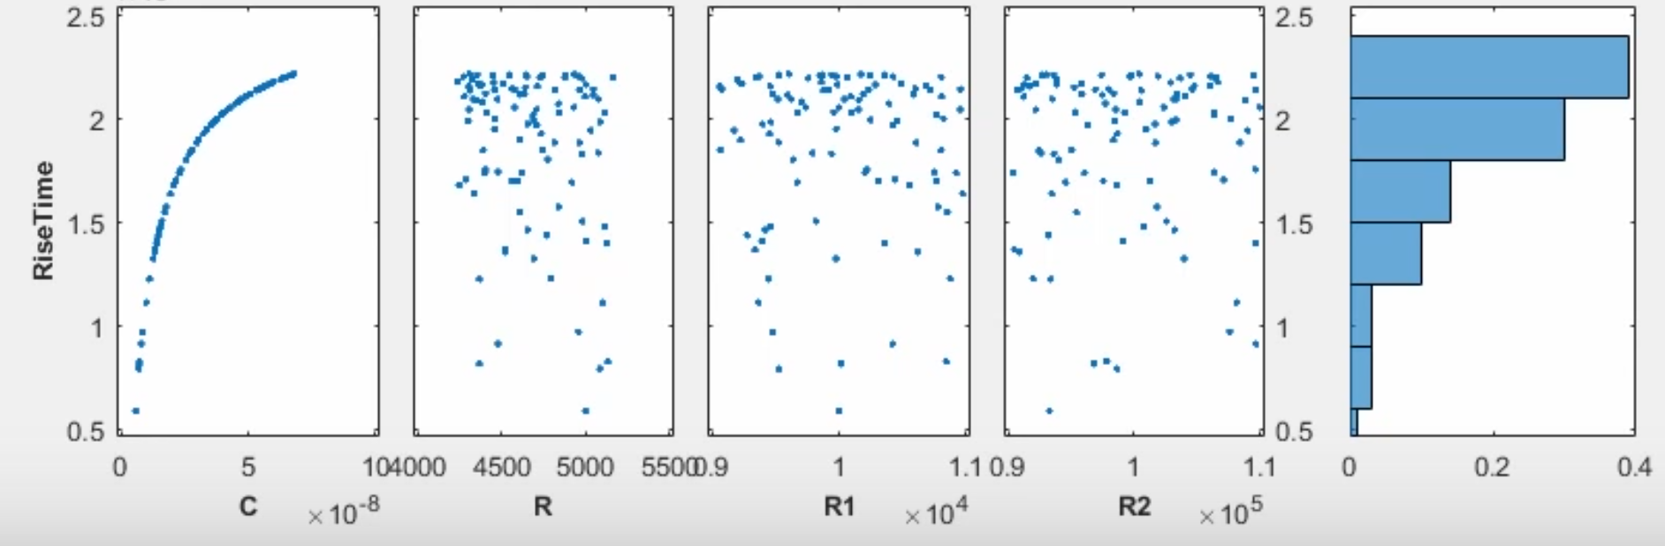
Sensitivity analysis
Objective: Minimize the rise time of the voltage at the output by looking at the parameters C, R1, R2 and R3
Notes:
Source: Design Exploration Using the Sensitivity Analysis Tool, Matlab, https://www.youtube.com/watch?v=hNweoL4l97w

Slide 33
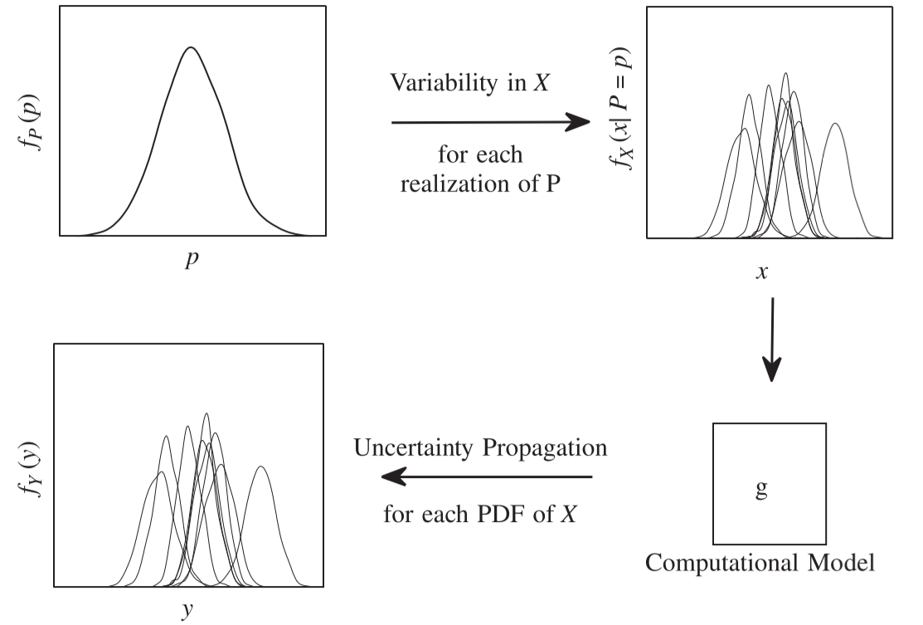
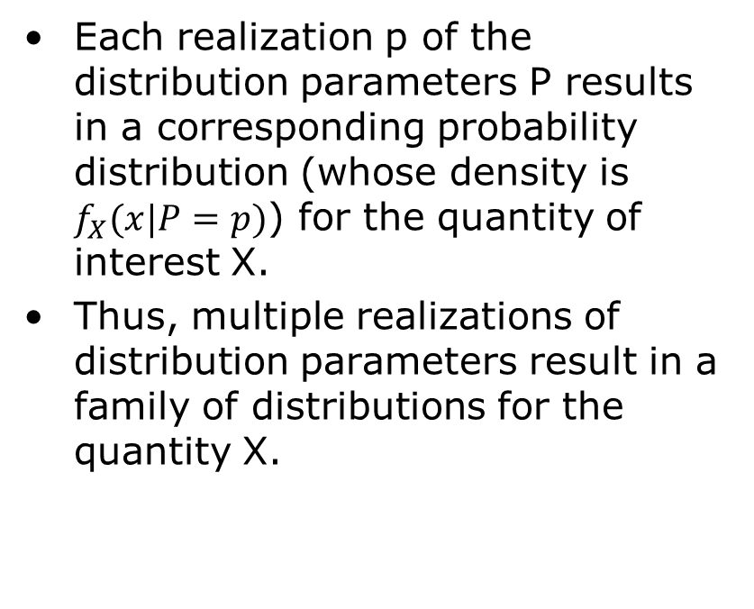
Including variability and parameter uncertainty in sensitivity analysis
Each realization p of the distribution parameters P results in a corresponding probability distribution (whose density is $f_{X}(x|P=p)$) for the quantity of interest X.
Thus, multiple realizations of distribution parameters result in a family of distributions for the quantity X.
S. Sankararaman, S. Mahadevan, Separating the contributions of variability and parameter uncertainty in probability distributions, Reliability Engineering and System Safety, 112 (2013) 187–199.

Slide 34
Uncertainty related resources - Courses
With Videos
Uncertainty Quantification in Engineering Science
http://eclass.uth.gr/eclass/courses/MHXB124/
Introduction to Uncertainty Quantification
https://www.ima.umn.edu/2014-2015/ND6.15-26.15/#
Without videos
MA 540 Uncertainty Quantification for Physical and Biological Models
http://www4.ncsu.edu/~rsmith/MA540_s17.html

Slide 35
Uncertainty related resources - Books
F. Pavese, A. B. Forbes, Data Modeling for Metrology and Testing in Measurement Science, Springer, 2009.
S. V. Gupta, Measurement Uncertainties, Physical Parameters and Calibration of Instruments, Springer-Verlag Berlin Heidelberg 2012.
I. Lira, Evaluating the Measurement Uncertainty: Fundamentals and Practical Guidance, IoP 2002.
H. W. Coleman, W. G. Steele, Experimentation, validation and uncertainty analysis for Engineers, Wiley, 2009.
A. Zoubir, D. R. Iskander, Bootstrap techniques for signal processing, Cambridge University Press, 2004.
W. Q. Meeker, G. J. Hahn, L. A. Escobar, Statistical Intervals: A Guide for Practitioners and Researchers, 2nd Edition, Wiley, 2017.
R. C. Smith, Uncertainty Classification: Theory, Implementation and Applications, SIAM, 2014.
K. Beven, Environmental Modelling: An Uncertain Future?, Taylor & Francis e-Library, 2010.

Slide 36
References
Sankaran Mahadevan, “Modeling and Data Uncertainties,” presentation, NASA/NAI Summer Design Institute on Uncertainty, Hampton, VA, July 20, 2011
William F. Guthrie,1 Hung-kung Liu,2 Andrew L. Rukhin,3 Blaza Toman, Jack C. M. Wang,5 Nien fan Zhang, Three Statistical Paradigms for the Assessment and Interpretation of Measurement Uncertainty, from Data Modeling for Metrology and Testing in Measurement Science by Franco Pavese and Alistair B. Forbes
BIPM, IEC, IFCC, ISO, IUPAC, IUPAP, and OIML. Guide to the expression of uncertainty in
measurement, International Organization for Standardization. GUM 1995 with minor corrections. Corrected version 2010. JCGM 100:2008.
BIPM, IEC, IFCC, ISO, IUPAC, IUPAP, and OIML. Evaluation of measurement data — Supplement 1 to the Guide to the expression of uncertainty in measurement — Propagation of distributions using a Monte Carlo method. JCGM 101:2008.

